Slide 1
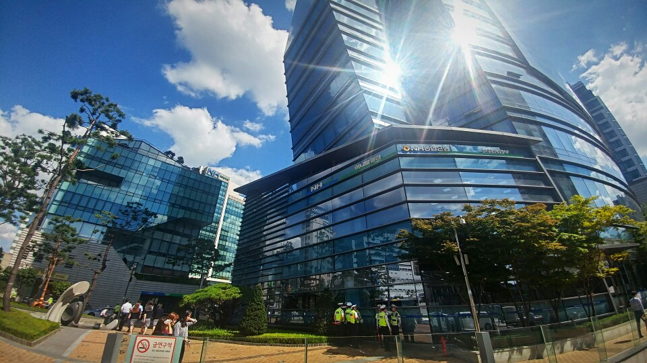
Introduction to NACF, NH Cok Bank
National Agricultural Cooperative Federation

Slide 2
Contents
Ⅰ. Introducing NACF
Overview
History
Business network
Ⅱ. NH Cok Bank
Background
Definition
Main service

Slide 3
Contents
Ⅲ. Cok Farm, Cok Food
<Cok Farm>
Overview
Main service
<Cok Food>
Overview
Main service
Ⅳ. Vision of NH Cok Bank

Slide 4
01
Introducing NACF

Slide 5
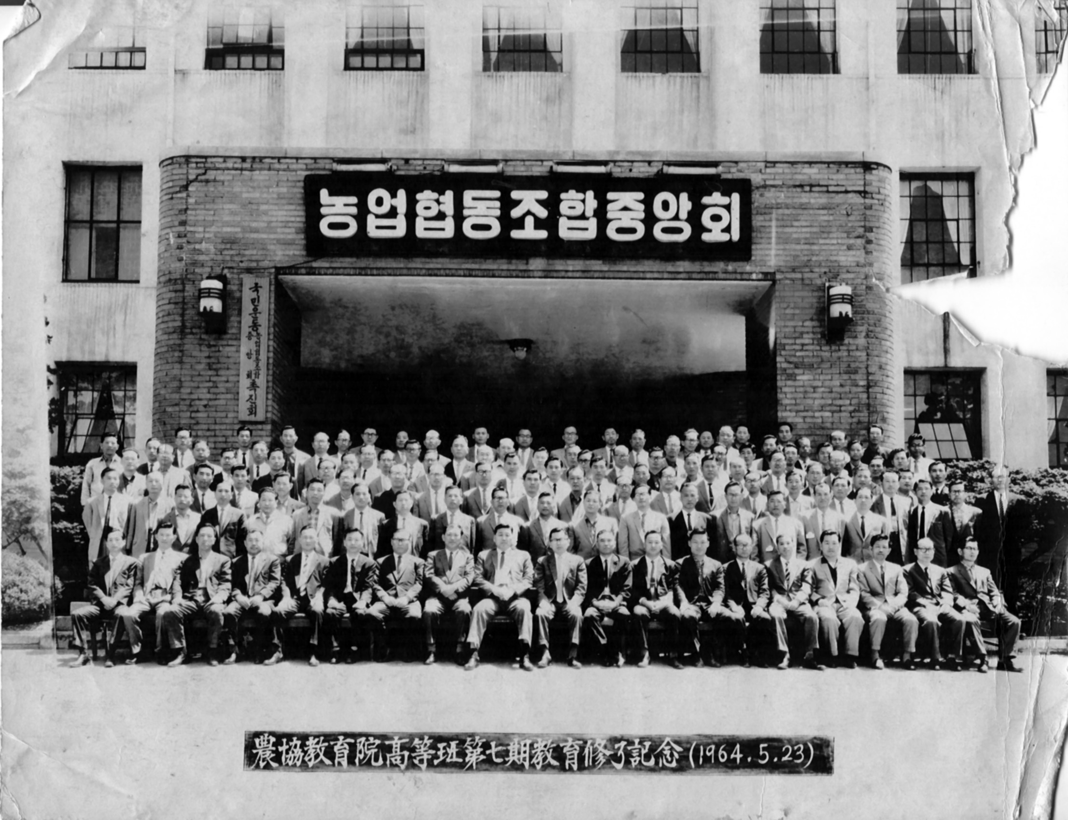
Established on 15 August 1961
Ⅰ. Introducing NACF - Overview
Establishment & Mission
as an integrated agricultural cooperative organization
by combining
National Agricultural Cooperatives
and NongEop Bank(Agricultural Bank).
Mission
To improve economic, social and cultural status of farmers in Korea.

Slide 6
Ⅰ. Introducing NACF - Overview
Membership & Ownership
2.2 Million Co-op Members
Dividends on Equity & Patronage Refunds
Extension & Support Business
Co-op Investments
1,131 Member Cooperatives
(Agricultural, Livestock, and Ginseng)
NACF Investments
National Agricultural Cooperative Federation (NACF)
(2018년기준)

Slide 7
Ⅰ. Introducing NACF - Overview
Operational Structure
National Agricultural Cooperative Federation (NACF)
NongHyup Agri-Business Group
NongHyup Financial Group
16 Affiliate Companies
7 Affiliate Companies
NongHyup Hanaro Mart
Korea Agricultural Cooprative Marketing
Agricultural Cooperative Chungbuk Marketing
Agricultural Cooperative Kyongnam Marketing
Daejeon Agricultural Products Marketing Center
Agricultural Cooperation
NongHyup Food Grain
NamHae Chemical
NongHyup Chemical
Nongwoo Bio
NongHyup Red Ginseng
NongHyup Agro
NongHyup Heuksarang
NongHyup Logis
NH Trading
NongHyup Feed
NongHyup Moguchon
NH Bank
NH Life Insurance
NH Property & Casualty Insurance
NH Investment & Securities (NH Future)
NH - Amundi Asset Management
NH Capital
NH Savings Bank

Slide 8
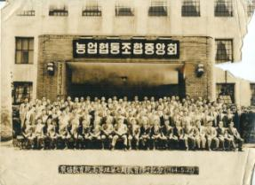
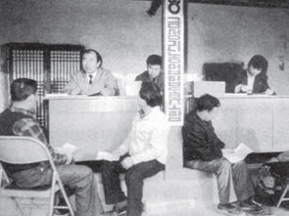
Ⅰ. Introducing NACF - History
History of NACF in 1960s
1961
Established by combining Agricultural Cooperatives and Agricultural Bank in accordance
with Agricultural Cooperative Act.
1969
Starting Cooperative Banking business, which alleviated high-interest loan problems
in rural areas.

Slide 9
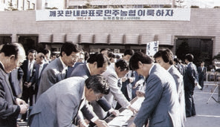
Ⅰ. Introducing NACF - History
History of NACF in 1980s
1981
Restructuring the organization from 3-tier to 2-tier organization,
consisting of Member Cooperatives and NACF.
Member Cooperatives
Regional
Cooperatives
NACF
1989
Introducing Direct Election System
for Cooperative Presidents and the Chairperson of NACF.

Slide 10
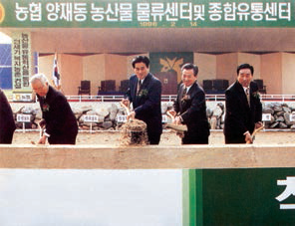
Ⅰ. Introducing NACF - History
History of NACF in 1990s
1995
Initiating independent operation of Marketing-Supply
and Banking-Insurance divisions.
1998
Hanaro Club, Korea’s first large outlet specializing in agricultural products,
opened for business.

Slide 11
Ⅰ. Introducing NACF - History
History of NACF in 2000s
2000
Integrated NACF was launched with the merger of the agricultural, livestock, and ginseng cooperative federations.
2011
Starting ‘I Love Farm Campaign’ to increase the people’s awareness
of the value of agriculture, farming, food security, organic food and etc.

Slide 12
Ⅰ. Introducing NACF - History
History of NACF in 2000s
2012
Organization was restructured into 1 federation
and 2 separate holding companies:
NongHyup Agribusiness Group and NongHyup Financial Group.
2013
AnSeong Agri-food Distribution Center was opened
in order to reduce the distribution channels and costs
between farmers and customers.

Slide 13
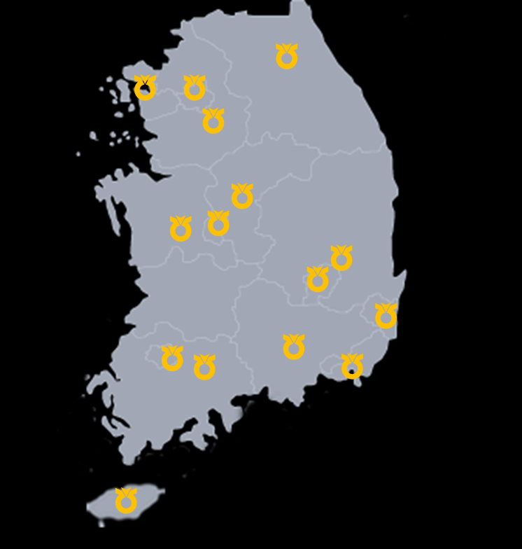
Ⅰ. Introducing NACF - Business network
Domestic Network
Regional Head Offices 16
Regional Cooperatives 1,131
Agricultural Cooperatives 936
Livestock Cooperatives 116
Commodity Cooperatives 68
Ginseng Cooperatives 11
Cooperative Banking Branches 4,649
NH Bank Branches 1,151

Slide 14
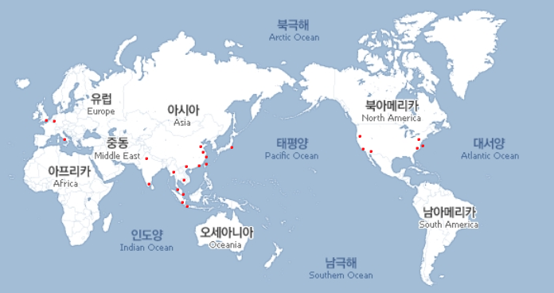
Ⅰ. Introducing NACF - Business network
Global Network
Subsidiaries of Agri-Business 14
Subsidiaries of Financial Group 17
International Networks (ICA, ICA-AP) 2
Total 33

Slide 15
02
NH Cok Bank

Slide 16
Ⅱ. NH Cok Bank – Background
Changes in digital financial environment
Fourth Industrial Revolution, future of finance
Digitalization | Unbundling | Intelligence
Changes in financial channels · Development of ICT technology · Tact → Untact channel | Weakened governance of existing finance · Emergence of new player (FinTech) → Kakao Bank, TOSS, K-Bank | Service intellectualization and personalization · Spread of the 4th Industrial Revolution technology → Accelerated quality gap among banks
Changes in Finance
Declined traditional financial industry
→ Acceleration of Digital Transformation in financial sector

Slide 17
Ⅱ. NH Cok Bank – Background
- Own both finance and distribution channels
- Financial knowhow + distribution network
= New platform
Strength
of NHCF
Differentiating from other financial firms
→ Building <NH Cok Bank>, a mobile platform specialized in Agricultural and Livestock Cooperatives

Slide 18
Ⅱ. NH Cok Bank – Definition
A simple mobile banking application built on Fin Tech technology that users can check balance, remittance, payment and
other life finance through simple authentication.
Cok Food (Shopping)
Users can buy conveniently
the fresh agricultural
and livestock product of NACF.
Cok Farm (Information)
A mobile communication channel between copartners and NACF.

Slide 19
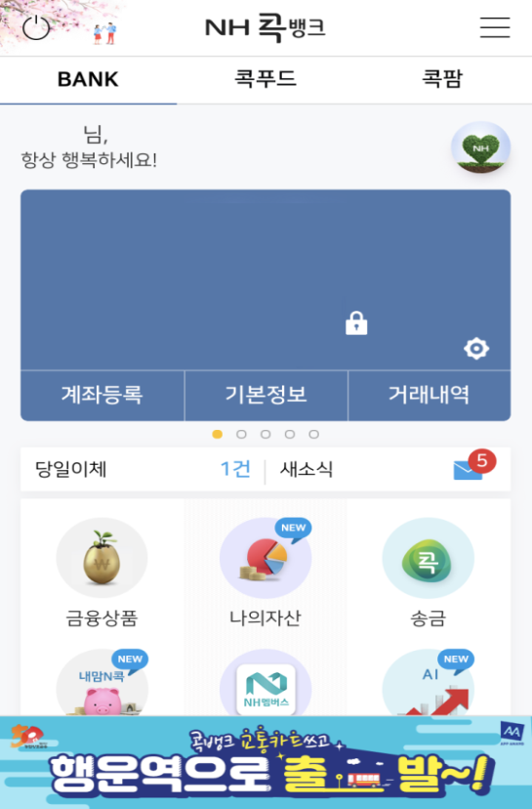
Ⅱ. NH Cok Bank – Main Screen
BANK
BANK
Cok Food
Cok Farm
A simple login
without a financial authentication certificate
Financial transaction: checking bank statement, remittance, foreign exchange, deposit, loan, etc.
Life finance: paying utility bills, transport card, etc.
Affiliated benefits: recommending stocks, giving a gift, etc.
내맘N콕통장
352-0123-2345-56
215,000,000원

Slide 20
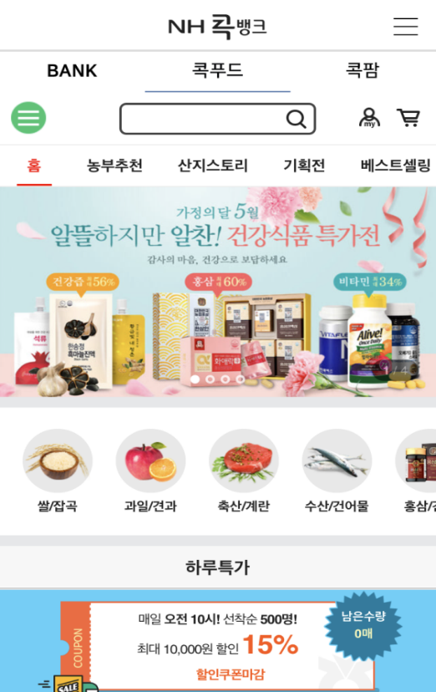
Ⅱ. NH Cok Bank – Main Screen
Cok Food
BANK
Cok Food
Cok Farm
Buy conveniently reliable and fresh agricultural and livestock product (order/delivery)
Sell 17,000 items under four categories

Slide 21
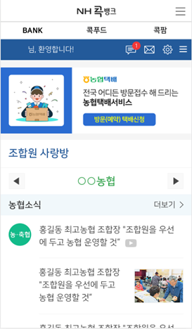
Ⅱ. NH Cok Bank – Main Screen
Cok Farm
BANK
Cok Food
Cok Farm
Provides information on investment of copartners, market price of agricultural product,
detailed shipment of agricultural product,
details on purchase of agricultural materials,
news on NACF and each region, etc.
Introduced door-to-door delivery service
(May, 2019)

Slide 22
Ⅱ. NH Cok Bank – Main Performances
Current state of NH Cok Bank
Accumulated Amount of Commissions Generated
1,314 Billion KRW
User Rating
at Google Playstore
4.3/5 Points
No. of Members
Over 4.65 Million
Accumulated Amount
of Remittance
21 Trillion KRW
Effective
Client Ratio
81%
(As of the end of June, 2019)

Slide 23
Ⅱ. NH Cok Bank – Main Service
Balance Inquiry
내맘N콕통장
352-0123-2345-56
215,000,000원
Shows your account balance of Cok Bank

Slide 24
Ⅱ. NH Cok Bank – Main Service
Account Signup
내맘N콕통장
352-0123-2345-56
215,000,000원
Register the bank account
that you are using in Cok Bank
(5 accounts max.)

Slide 25
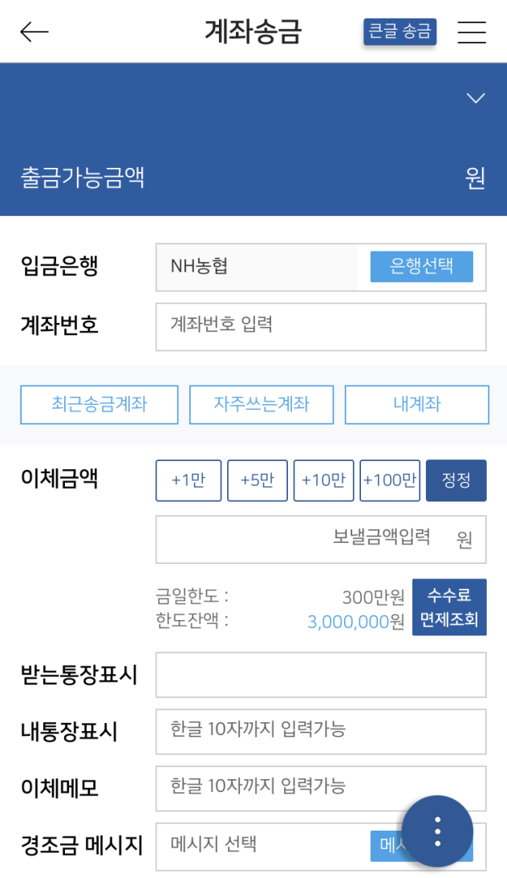
Ⅱ. NH Cok Bank – Main Service
Remittance
Remit up to 3 million KRW a day
without a particular security medium
자립예탁금
352-0123-2345-11
“Enlarged character” service for the elderly clients
2,631,000
Remittance service
: account remittance, voice remittance,
Kakaotalk remittance, message remittance
＊Voice remittance
: An account transfer service
that anyone can do with his/her voice

Slide 26
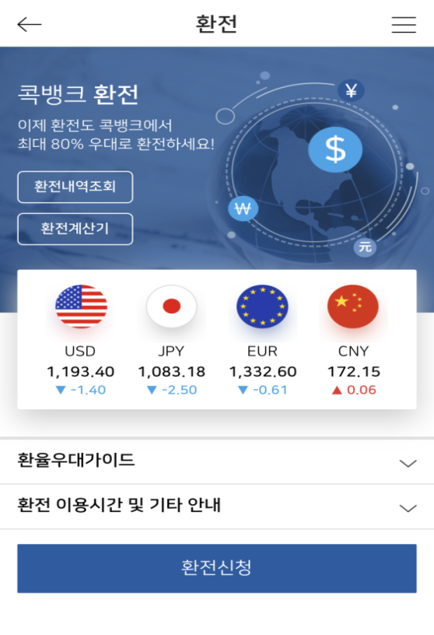
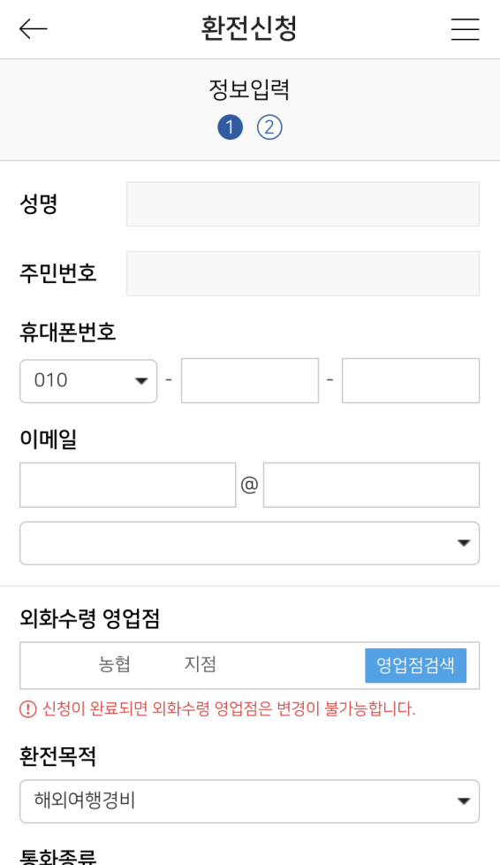
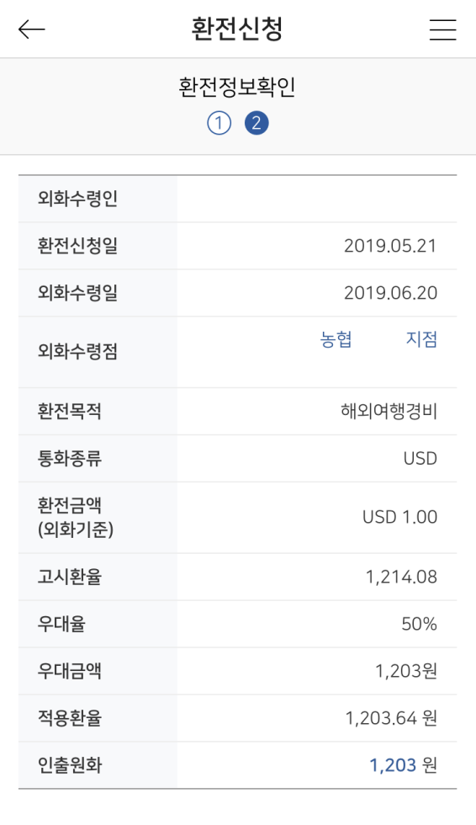
Ⅱ. NH Cok Bank – Main Service
F/X Service
At the branch where a user requests,
the user can receive foreign or Korean currency.
○○
○○
○○
○○

Slide 27
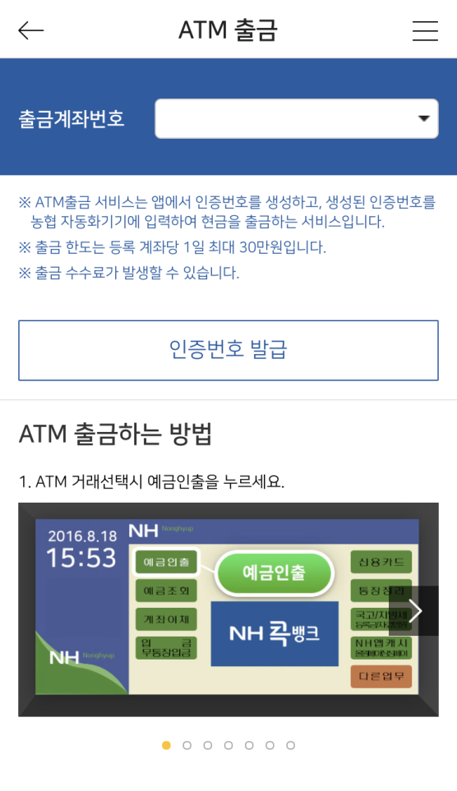
Ⅱ. NH Cok Bank – Main Service
Using the Cok Bank verification code,
the user can withdraw cash
(Up to 300,000 KRW per day)
ATM Withdrawal
352-0123-2345-11
① Select withdrawal account number
③ Enter the verification code to ATM
↓
④ Enter the amount
↓
⑤ Enter the secret access number
↓
⑥ Withdraw the cash
② Issue the verification code
NACF ATM

Slide 28
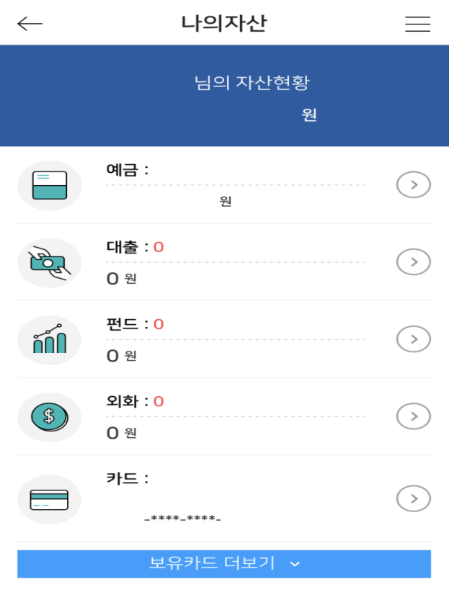
Ⅱ. NH Cok Bank – Main Service
My Asset
Shows my asset status at a glance.
The customer uses it for his/her asset management.
Inquire total asset in NACF
(Deposit, installment savings,
fund, loan, f/x)
홍길동
2,631,000
2
2,631,000
Check your NACF accounts and balance
Inquire your cards possessed, card statement, limit of use, etc.
1
5241
1111

Slide 29
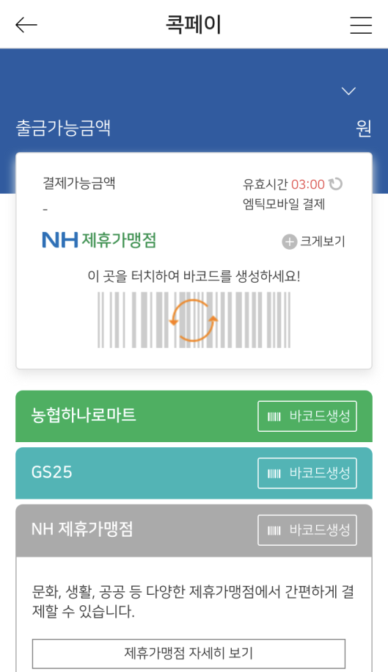
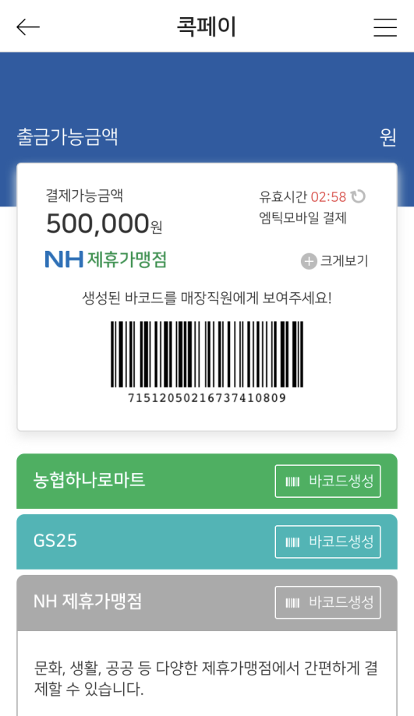
Ⅱ. NH Cok Bank – Main Service
Payment service using mobile bar codes
(Hanaro Mart, GS25 / Up to 500,000 KRW per day)
Cok Pay
자립예탁금
352-0123-2345-11
자립예탁금
352-0123-2345-11
자립예탁금
352-0123-2345-11
2,631,000
2,631,000
2,631,000
Designate
withdrawal accout
Generate bar codes
Pay

Slide 30
Ⅱ. NH Cok Bank – Main Service
Life Finance Service
Paying Utility Bill
Transportation Card
GIRO, Local taxes, electricity, etc.
Register a transportation card
and use for transportation service by using the account balance
Stock Information
Giving a gift
Recommend stocks and
stock information
with a robo-adviser
Buying and presenting
a mobile coupon (Gifticon)

Slide 31
03
Cok Farm, Cok Food

Slide 32
Ⅲ. Cok Farm – Overview
Definition
Direct and indirect communication channel
for copartners and clients through a mobile platform
Agricultural and Livestock Cooperatives
Copartners
/clients
NACF
/Affiliates
Features
Agricultural and Livestock Cooperatives, and NACF
and its affiliates offer farming information
and NACF usage record to copartners and clients.
(A membership service for copartners)

Slide 33
Ⅲ. Cok Farm – Main Service
Ordinary Member
(My Hometown News, Supporting system for farmers,
Urban and Rural, market price of agricultural product)
Menu/Function

Slide 34
Ⅲ. Cok Farm – Main Service
Menu/Function
Copartners
(Copartner’s blog, NACF news, family event, NACF use record. )

Slide 35
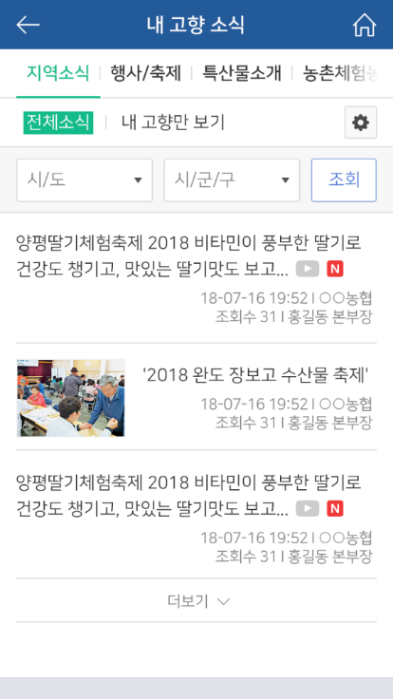
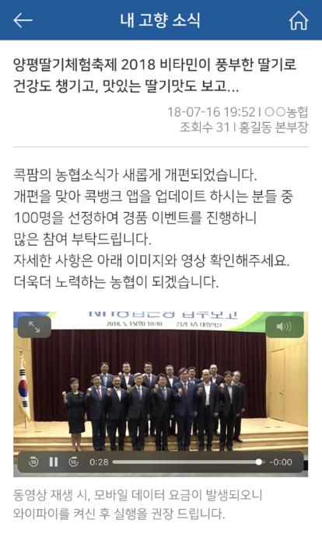
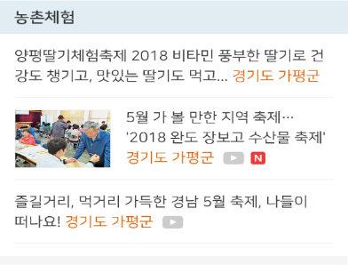
Ⅲ. Cok Farm – Main Service
My Hometown News
(local news, events/festivals, local specialty, experiencing rural life)

Slide 36
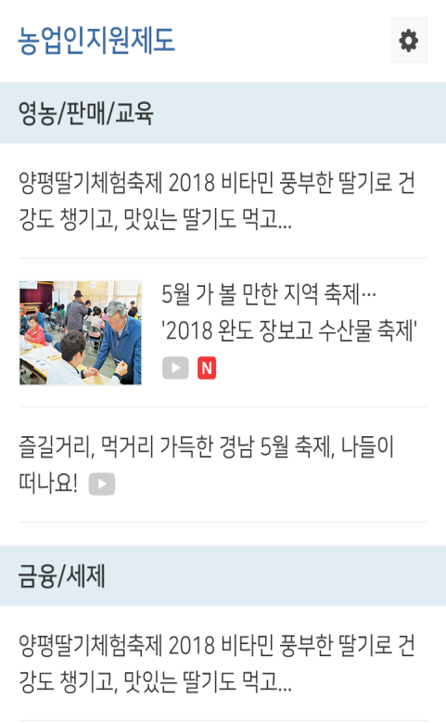
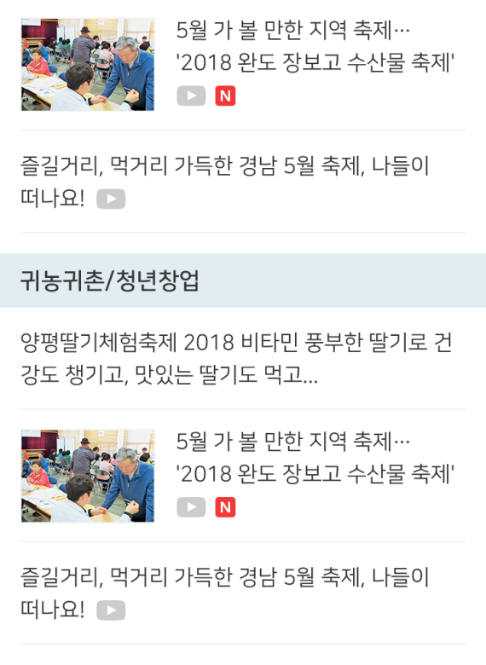
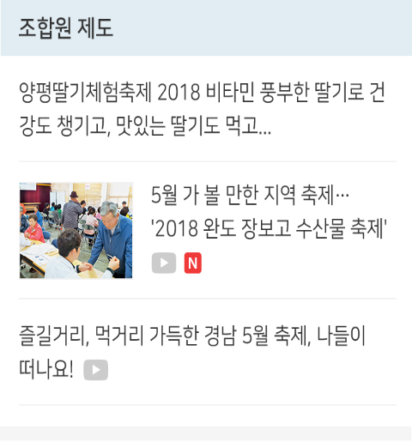
Ⅲ. Cok Farm – Main Service
Supporting system for farmers
(farming/sales/training, finance/tax, returning to farm/hometown,
youth startup, copartner system)

Slide 37
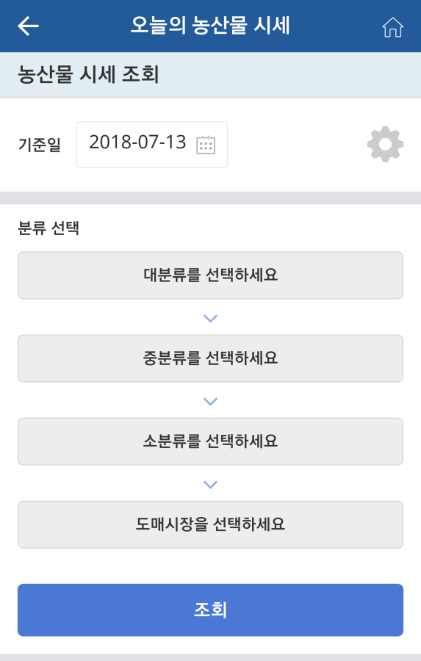
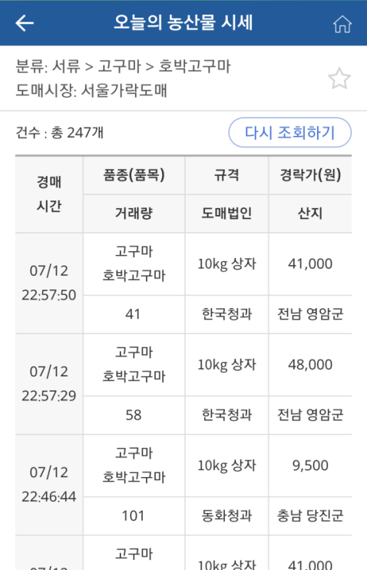
Ⅲ. Cok Farm – Main Service
Market price of agricultural product
(offers price information of agricultural product at NACF joint market)
#5

Slide 38
Ⅲ. Cok Farm – Main Service
Urban and Rural
(Offers contents linked to the Farmer’s Newspaper, Farm Stay,
and Smart Farm TV)
농촌
도시

Slide 39
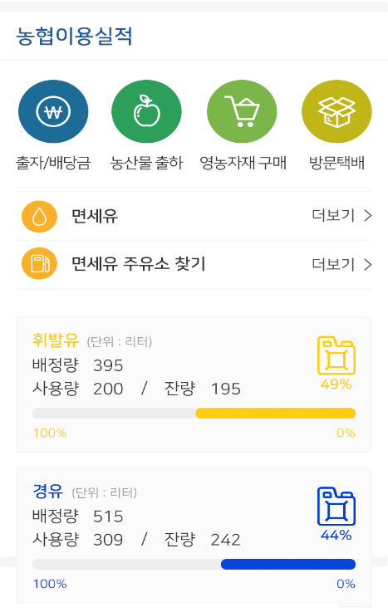
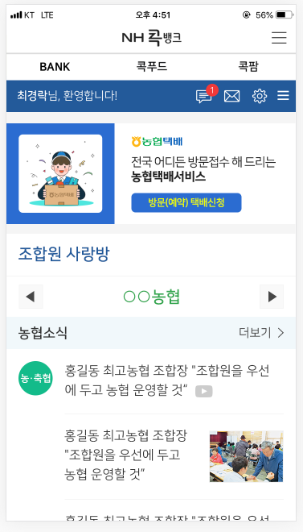
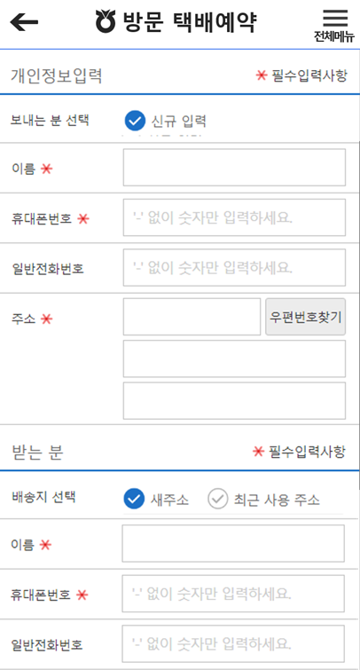
Ⅲ. Cok Farm – Main Service
⑤ Door-to-door Delivery Service
(A delivery company visits the farmer to collect the delivery item)

Slide 40
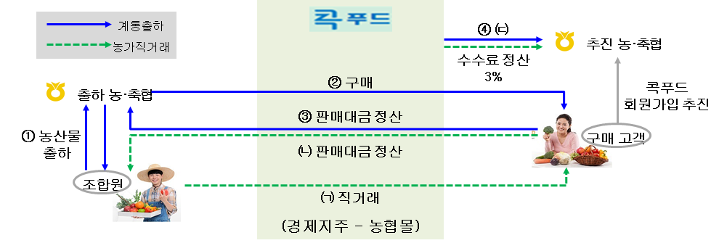
Ⅲ. Cok Food – Overview
Definition
A mobile shopping mall where sells the agricultural product
produced by farmers and copartners.
Route sales
Co-op
Promoting Cusstomers
Direct Deals
Adjust fee
Buy
Promoting
Customers
to sign in
Cok-food
Shipping Co-op
Adjust money
Shipping
Agricultural products
Customer
Adjust money
Co-op
member
Direct deal
Agri-Business Group
Nonghyup mall

Slide 41
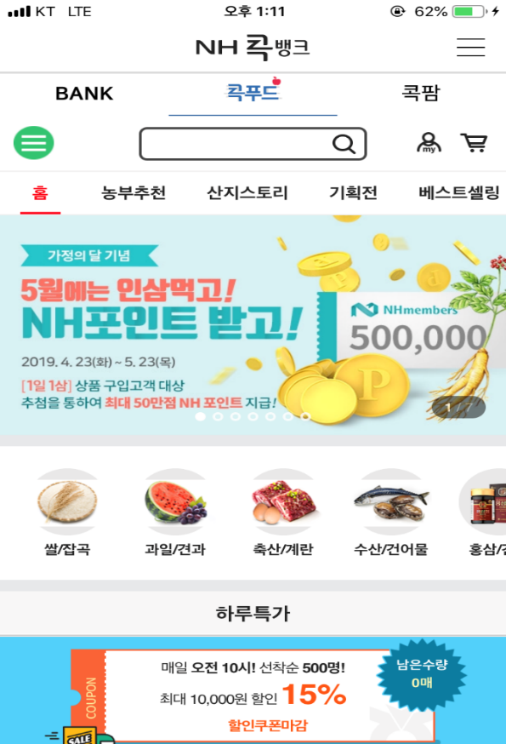
Ⅲ. Cok Food – Main Screen
Cok Food Main Menu
Farmer’s choice
Origin story
Special events
Best sellers

Slide 42
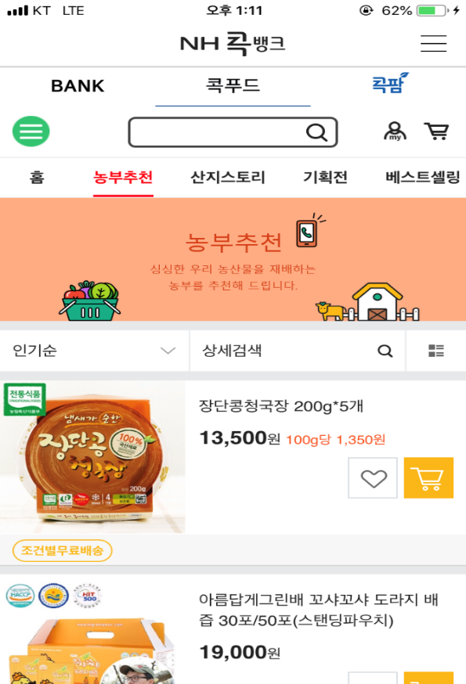
Ⅲ. Cok Food – Main Service
① Farmer’s Choice
Farmer’s Choice
A direct dealing market
where sells the product
recommended by farmers
such as‘Farmers and Fishers Company’, ‘The 6th Industry’, ‘Young Farmers’, etc.

Slide 43
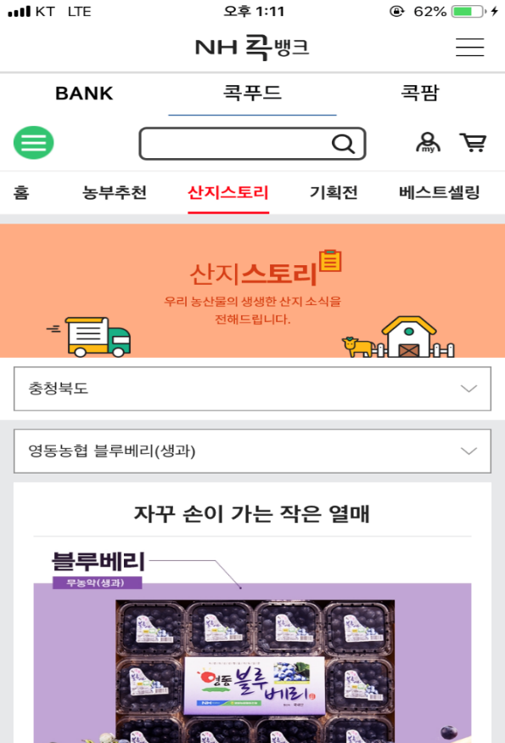
Ⅲ. Cok Food – Main Service
② Origin Story
Origin Story
Sells the product under the theme
of the origin of the agricultural product
raised in Korea

Slide 44
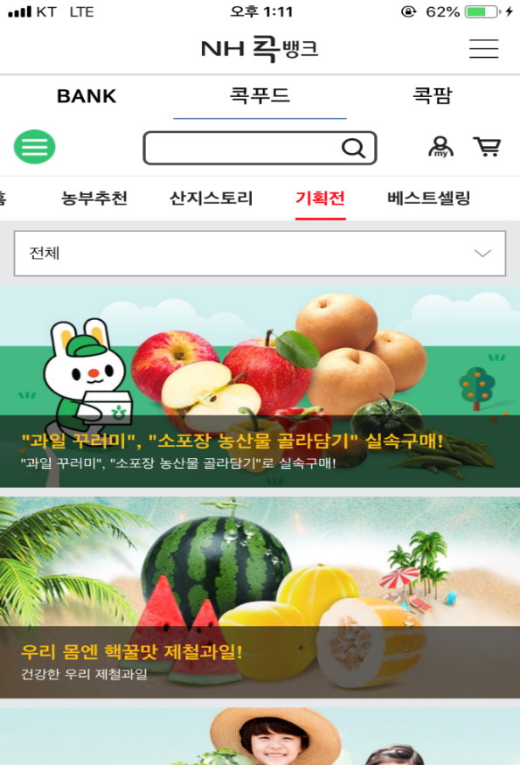
Ⅲ. Cok Food – Main Service
③Special Event
Special Event
A special event composed of the products chosen by merchandiser
with a special price and items
- Special discount
- Seasonal agricultural product
- Local specialties

Slide 45
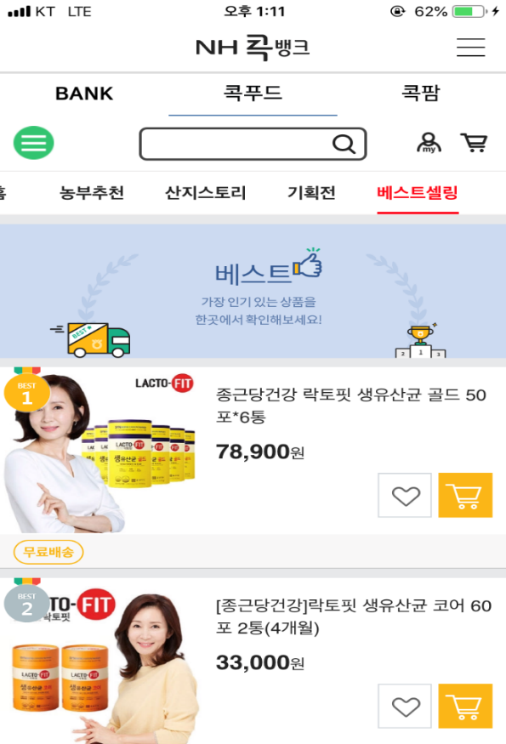
Ⅲ. Cok Food – Main Service
Best Sellers
Best Sellers
Presents top 100 items
that have been sold most
for the past two weeks at Nonghyup Mall

Slide 46
04
Vision

Slide 47
Ⅳ. NH Cok Bank - Vision
Vision of NH Cok Bank
Cok Bank
(Finance)
◈ Make a digital bank come true
focusing on core financial services
(Remittance, pay, financial product mall, life finance service)
◈ A portal service offering digital farming technology
and farming information
◈ A platform that links urban and rural areas
Cok Farm
(Information)
◈ A specialized shopping mall
that sells directly the agricultural product
(e-Hanro Mart, e-Local Food)
Cok Food
(Shopping)
Convergence of finance, information and shopping
Completing the one and only integrated mobile NACF platform in Korea

Slide 48
Question
&
Answer

Slide 49
Thank you!
심 National Agricultural Cooperative Federation

